Slide 1
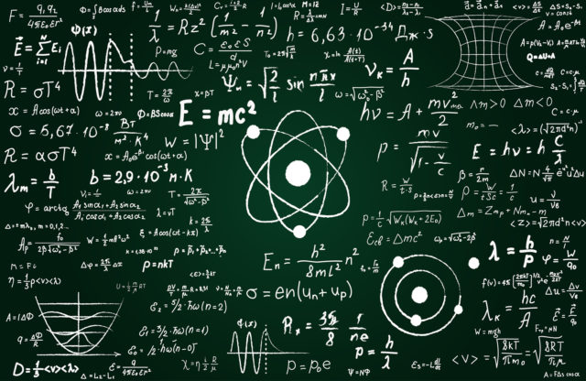
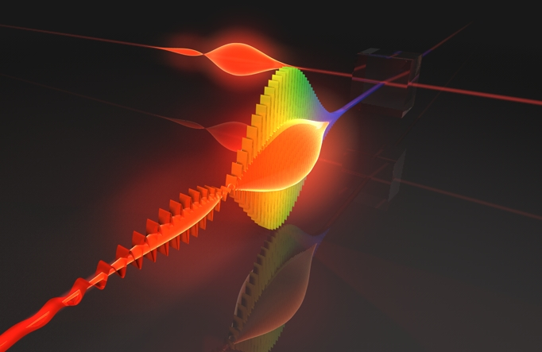
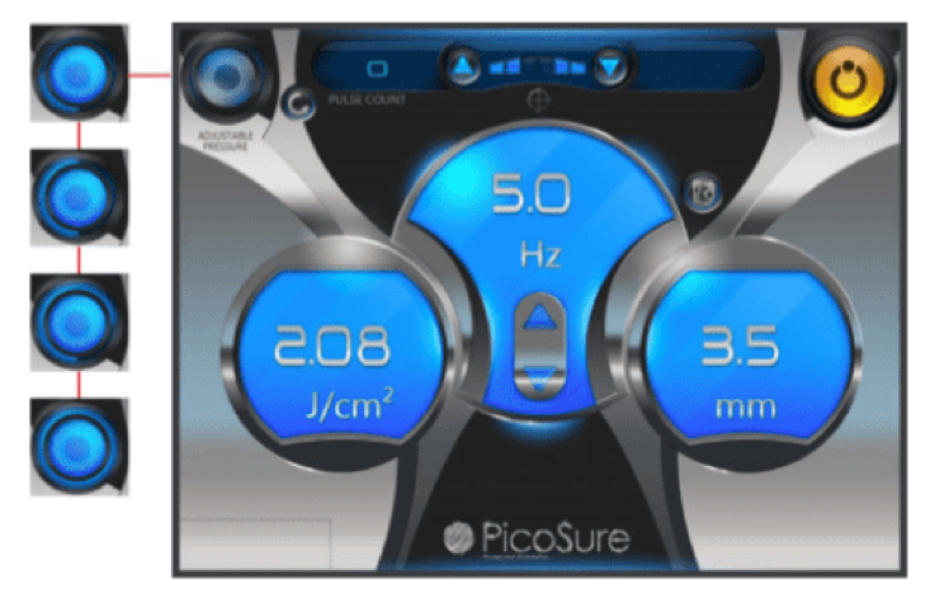
Understanding LASER & IPL Settings
Notes:
This class is designed to help you understand the relationship between LASER physics, tissue interaction, and how they help you determine safe and effective settings for LASER & IPL treatment.

Slide 2
Understanding LASER & IPL Settings
The Physics of Light
Laser & IPL Mechanics
Light/Tissue Interaction

Slide 3
An Introduction to Light Physics
Notes:
An understanding of the physics of light, and more specifically how light interacts with tissue will help us understand how we can use light to positively effect the skin imperfections common to aesthetic practice.

Slide 4
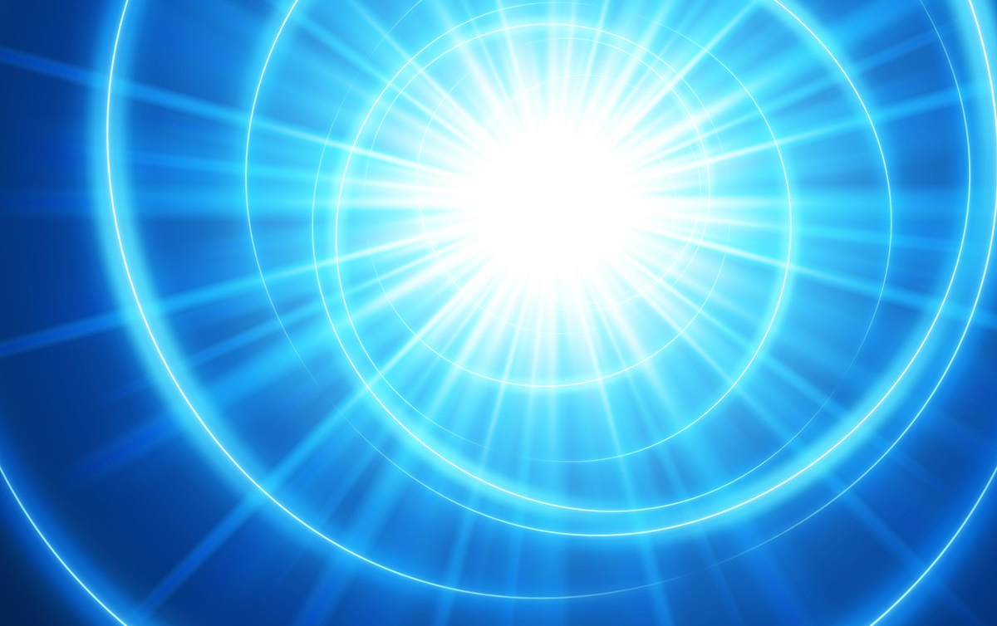
What is Light?
Notes:
What is Light? You think we would know by now… But in fact we do not. Light has been observed as a certain form of electromagnetic radiation, typically visible to the human eye. There are characteristics of light that indicate that it is made up of particles, and characteristics that indicate that light emanates as a wave, or a stream of relatively connected particles or some other as yet unidentified substance or “quanta”.

Slide 5
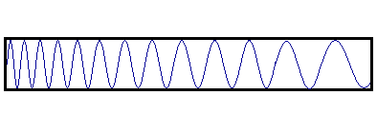
What is Light?
Notes:
Visible light is defined as emanating in wavelength in the range of 400 to 700 nanometers. With the colors closer to the ultraviolet having shorter wavelengths and the colors closer to the infrared having longer wavelengths.

Slide 6
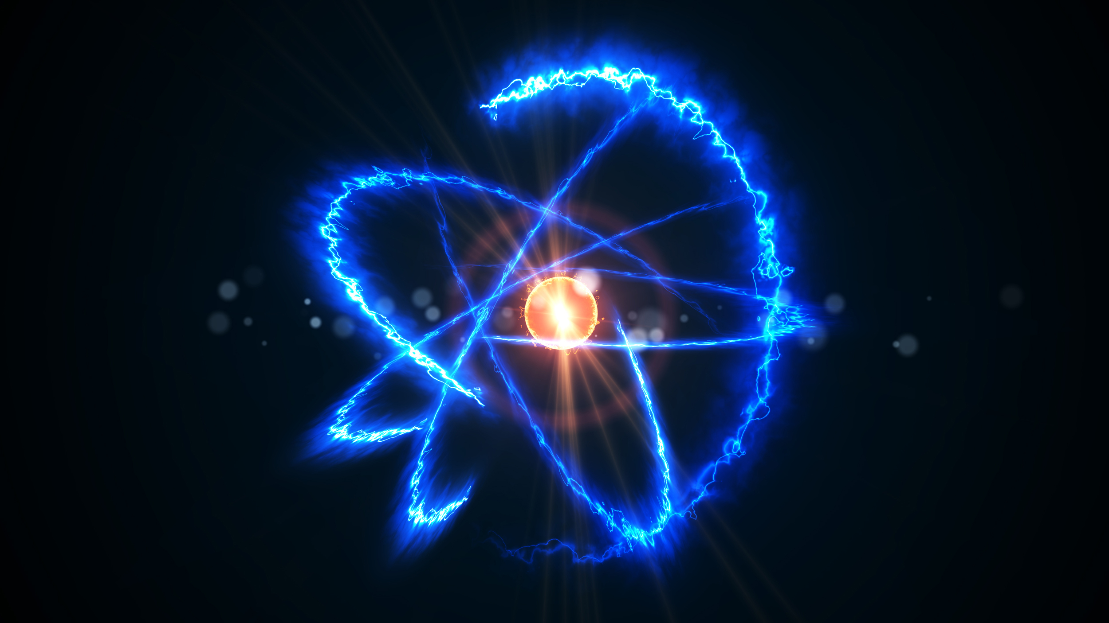
What is Light?
Notes:
The Speed of Light in a vacuum is about 186,000 miles per second or about 700 million miles per hour.

Slide 7
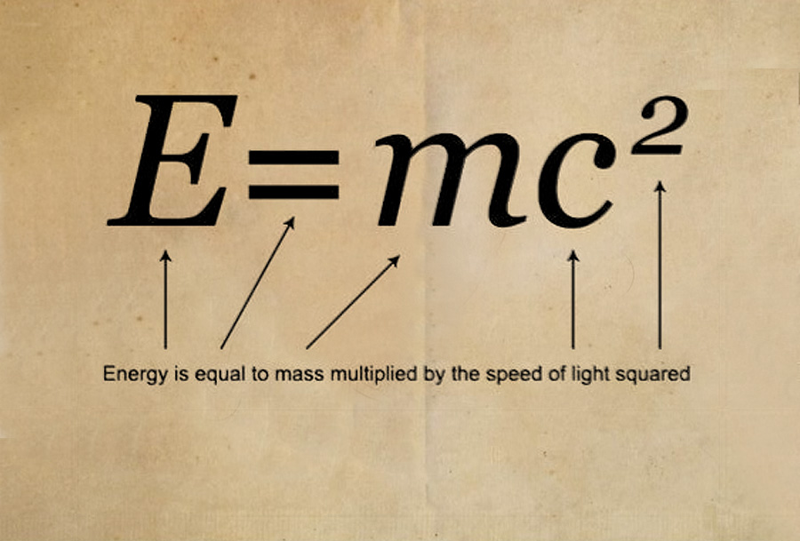
What is Light?
Notes:
The speed of light is the “C” in Einstein’s E=mc² and is one of the fundamental constants of the universe.

Slide 8
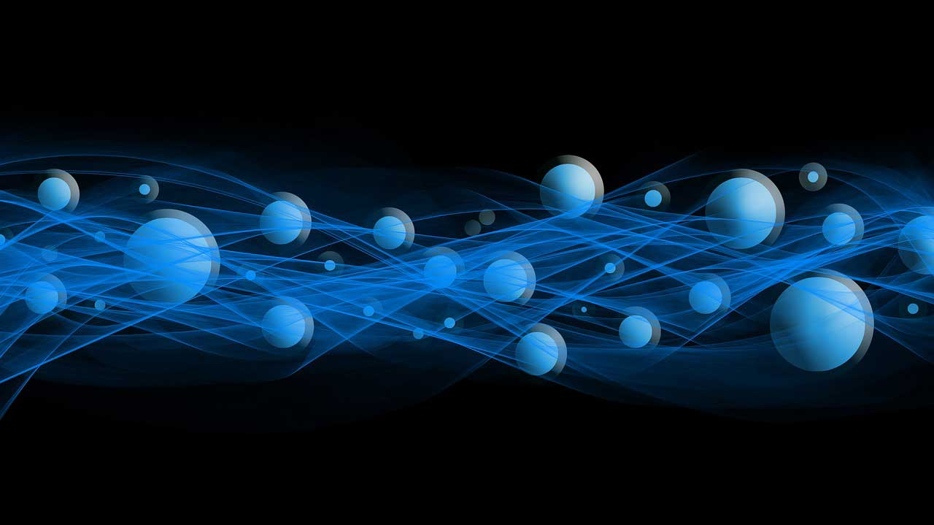
What is Light?
Notes:
Visible light is emitted and absorbed in tiny "packets" called photons.

Slide 9
What is Light?
Notes:
A photon is an elementary particle, and the force carrier for the electromagnetic force.

Slide 10
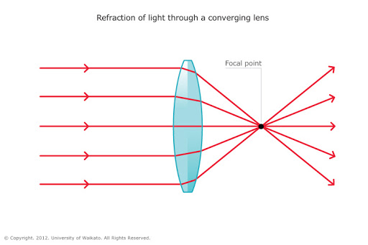
What is Light?
Notes:
A single photon may be refracted by a lens or exhibit wave interference with itself, but also act as a particle giving a definite result when its position is measured.

Slide 11
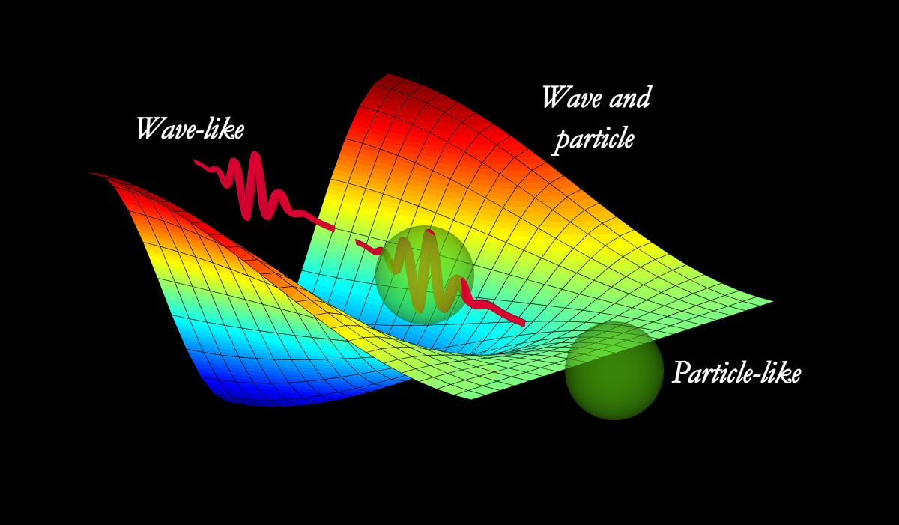
What is Light?
Notes:
So, photons exhibit properties of both waves and particles. This property is referred to as the wave–particle duality.

Slide 12
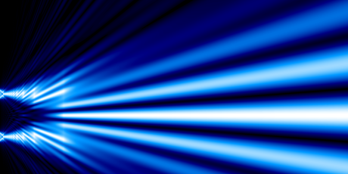
Dual Slit Experiment
Notes:
Who has heard of the Dual Slit Experiment?

Slide 13
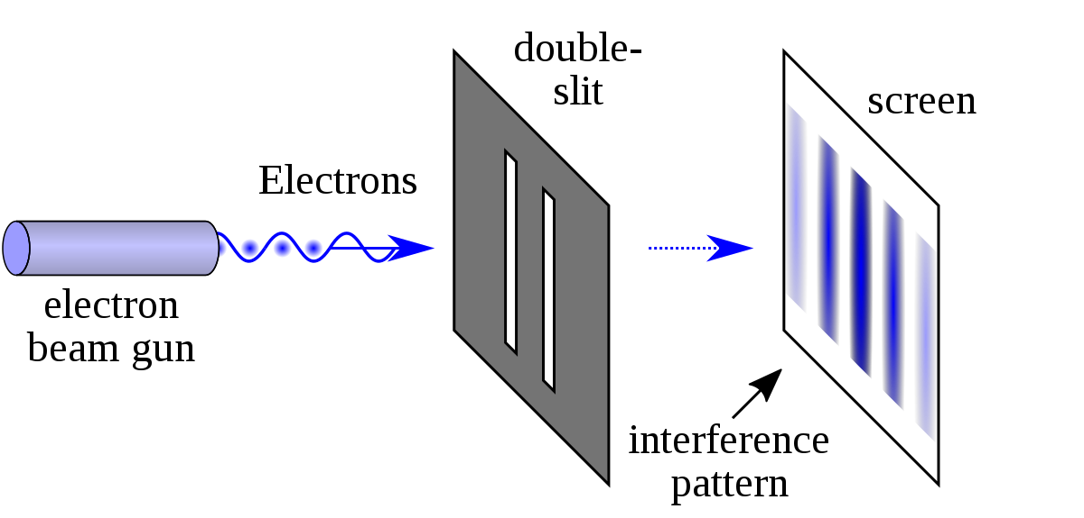
Dual Slit Experiment
Notes:
One of the most famous experiments in physics is the dual slit experiment. It demonstrates that little particles of matter also behave like waves, and suggests that the act of observing a particle has an effect on its behavior.

Slide 14
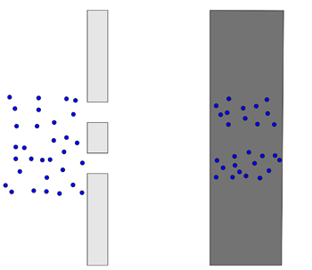
Dual Slit Experiment
Notes:
Imagine a wall with two slits in it. Imagine throwing tennis balls at the wall. Some will bounce off the wall, but some will travel through the slits. If there's another wall behind the first, the tennis balls that have travelled through the slits will hit it. If you mark all the spots where a ball has hit the second wall, what do you expect to see? That's right. Two strips of marks roughly the same shape as the slits.

Slide 15
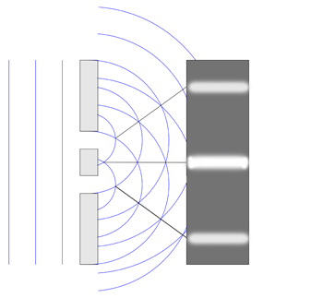
Dual Slit Experiment
An interference pattern.
Notes:
Now imagine shining a light (of a single color, that is, of a single wavelength) at a wall with two slits (where the distance between the slits is roughly the same as the light's wavelength). In the image, we see the light wave and the wall from the top. The blue lines represent the peaks of the wave. As the wave passes though both slits, it essentially splits into two new waves, each spreading out from one of the slits. These two waves then interfere with each other. At some points, where a peak meets a trough, they will cancel each other out. And at others, where peak meets peak (that's where the blue curves cross in the diagram), they will reinforce each other. Places where the waves reinforce each other give the brightest light. When the light meets a second wall placed behind the first, you will see a stripy pattern, called an interference pattern. The bright stripes come from the waves reinforcing each other.

Slide 16
Dual Slit Experiment
Notes:
Now let’s get into quantum mechanics. Imagine firing electrons at our wall with the two slits, but block one of those slits off for the moment. You'll find that some of the electrons will pass through the open slit and strike the second wall just as tennis balls would: the spots they arrive at form a strip roughly the same shape as the slit.

Slide 17
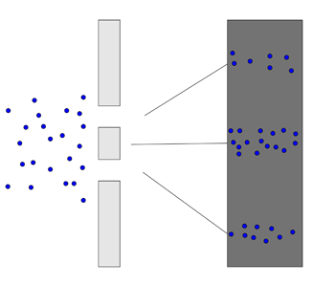
Dual Slit Experiment
Notes:
Now open the second slit. You'd expect two rectangular strips on the second wall, as with the tennis balls, but what you actually see is very different: the spots where electrons hit build up to replicate the interference pattern from a wave.

Slide 18
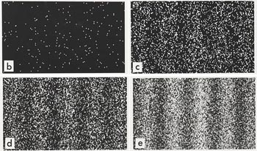
Dual Slit Experiment
Notes:
Here is an image of a real double slit experiment with electrons. The individual pictures show the pattern you get on the second wall as more and more electrons are fired. The result is a stripy interference pattern.

Slide 19
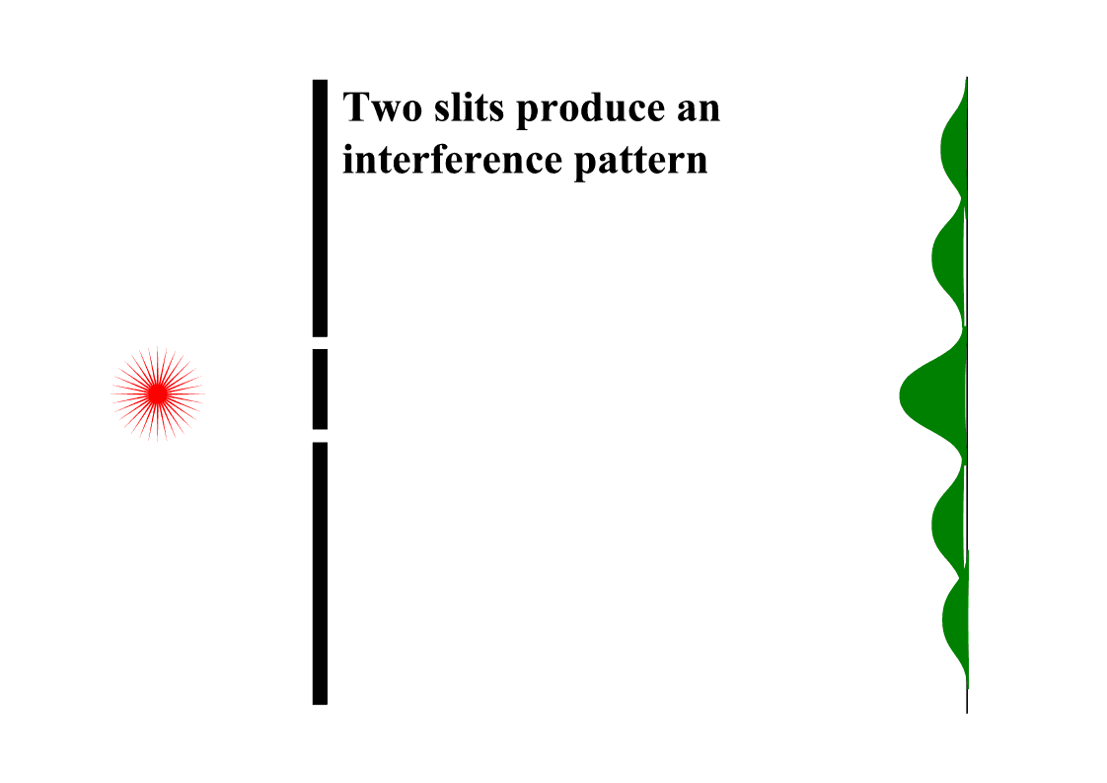
Dual Slit Experiment
Notes:
How can this be? One possibility might be that the electrons somehow interfere with each other, so they don't arrive in the same places they would if they were alone. However, the interference pattern remains even when you fire the electrons one by one, so that they have no chance of interfering. Strangely, each individual electron contributes one dot to an overall pattern that looks like the interference pattern of a wave.

Slide 20
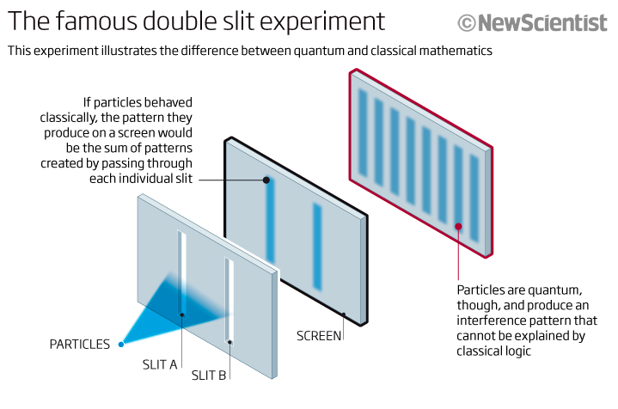
Dual Slit Experiment
Notes:
Could it be that each electrons somehow splits, passes through both slits at once, interferes with itself, and then recombines to meet the second screen as a single particle? To find out, you might place a detector by the slits, to see which slit an electron passes through. But if you do that, then the pattern on the detector screen turns into the particle pattern of two strips The interference pattern disappears. Somehow, the very act of looking ensures that the electrons travel like well-behaved little tennis balls. It's as if they knew they were being looked at, and decided to behave properly.

Slide 21
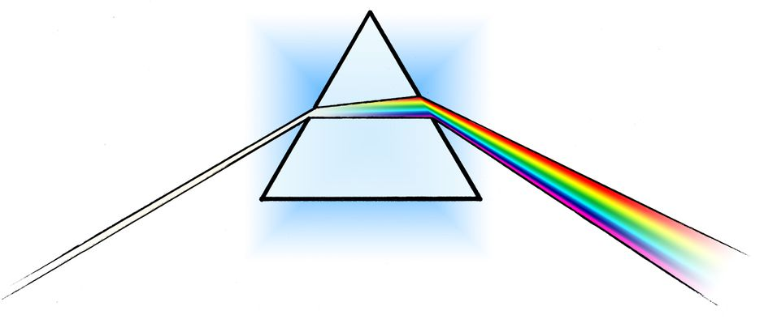
What is Light?
Notes:
To this day the greatest minds of physics continue to investigate the ultimate physical & quantum properties of light. While they research, we are able to observe, measure and utilize light, (and other forms of electromagnetic radiation) for a variety of applications, including treatment of the skin.

Slide 22
LASER Physics
Notes:
Lets get on to something that’s much more comprehensible: LASER physics. Why is LASER capitalized

Slide 23
L.A.S.E.R.
Light
Amplification by the
Stimulated
Emission of
Radiation
Notes:
LASER is an acronym

Slide 24
Laser Light
Monochromatic
Coherent
Collimated (non-divergent)
Notes:
LASER light is monochromatic, meaning one color, or wavelength. It is coherent, which may mean that all the photons emit wavefronts in unison. The light is Collimated, meaning all of the photons and their wavefronts are moving in the same direction, and do not diverge.

Slide 25
Laser Components
Notes:
There are 3 basic elements necessary to compose a laser system. First a Lasing medium, which may be a gas, crystal, liquid, or semiconductor. Second is a Source of Excitation for the lasing medium, for example, a flash lamp, radio frequency, high voltage discharge, diodes, and in some cases another laser. And then, Mirrors are needed to reflect the excited photons back into the lasing medium, within a resonant chamber that facilitates an amplification of wave front release. As the lasing medium is excited, molecules are stimulated to a higher energy level. Some of the excited molecules will spontaneously decay to back to the original lower energy, releasing a photon, and if the photon is emitted in the right direction, it will hit one of the mirrors at the ends of the resonant chamber and be reflected back into the excited lasing medium.

Slide 26
Generation of Laser Radiation
Notes:
This excited photon can "stimulate" another excited molecule to decay releasing another photon which travels in the same direction, which in turn is reflected back into the resonant cavity, stimulating emission of even more photons. If most of the molecules in the lasing medium are in the excited state, a "population inversion” occurs amplifying the light energy until it is released out one end of the resonant cavity.

Slide 27
Types of Lasers
Gas
Dye
Solid State
Semiconductor
Chemical
Notes:
Gas, CO2, Erbium – Dye, Green & Yellow Dye packs – Solid State, Ruby, Alexandrite, YAG – Semiconductor, 810 Diode – Chemical, involve fluoride, oxygen, iodine, none aesthetic

Slide 28
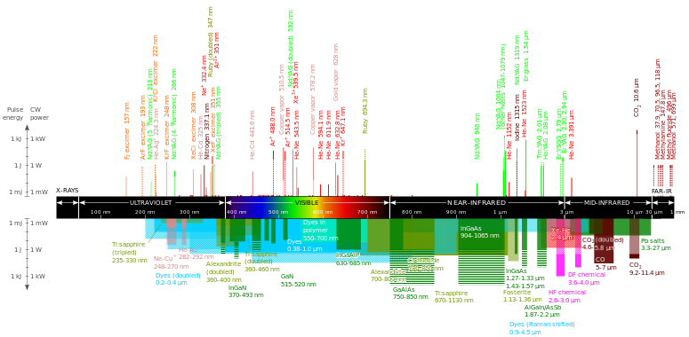
Types of Lasers
Notes:
There are a number of different lasing media that typically define a laser. Most lasers are referred to by their specific lasing media.

Slide 29
Common Aesthetic Lasers
Notes:
These are some of the wavelengths common to aesthetic LASERS. Nd YAG stands for Neodymium doped Yttrium Aluminum Garnet, or a synthetic garnet crystal doped with Neodymium ions. It is a solid state LASER, Erbium and CO2 are gasses, diode is a semiconductor, Dyes are pigments.

Slide 30
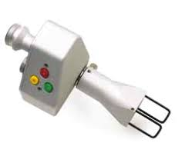
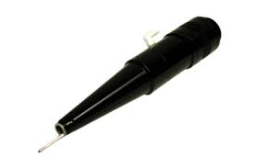
Notes:
For a LASER treatment skin should be clean and dry before the LASER is fired, and the LASER aperture is typically suspended a specific distance from the skin to ensure energy delivery is consistent.

Slide 31
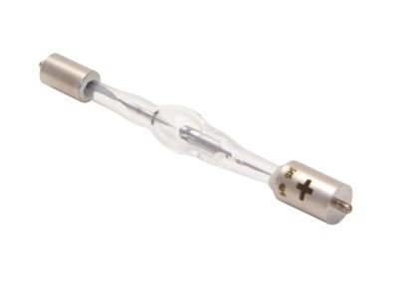
Pulsed Light
Notes:
Intense Pulsed Light becomes useable for aesthetic treatment when a powerful pulse of white light is manipulated to mimic laser characteristics. A high powered Xenon flash lamp, (named for the Xenon gas contained within) is energized, eliminating the need for a lasing medium. This allows us the ability to harness the power of many different colors of light from one source.

Slide 32
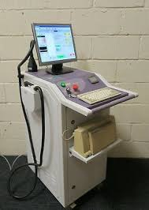
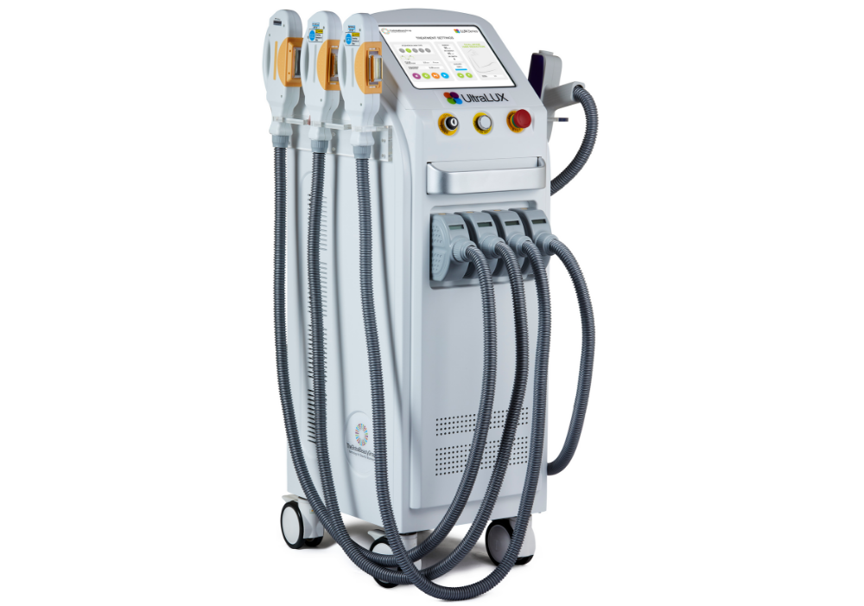
Pulsed Light
Notes:
The history of pulsed light technology began in 1994 with the introduction of the “Photoderm”. This basic design has been reproduced and improved upon by a number of manufacturers, making “intense” pulsed light, (or IPL) one of the most popular office based procedures in the plastic surgery, dermatology, and medi-spa industries.

Slide 33
The Difference Between Laser and Pulsed Light
Broad Spectrum
Non-coherent
Non-collimated (divergent)
Notes:
The difference between IPL and lasers. (read slide content).
IPL utilizes a broader range of the spectrum of colors or wavelengths.
LASER light is coherent, perhaps meaning that all the light “waves” are in phase (peak together). Or coherennt. IPL wavefronts are not coherent.
LASER photons flow parallel to each other, meaning that along a distance there is minimal loss of energy, they can be delivered through an optic fiber and can be focused. IPL light, like ordinary lamp, is divergent, the longer the distance the light travels, the more it spreads out, and the less energy it delivers.

Slide 34
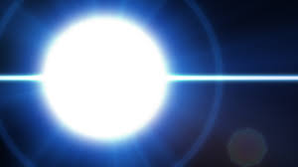
Pulsed Light
Notes:
The physics of pulsed light are made similar to those of LASER light because of the manipulation of this intense flash of white light by three means:

Slide 35
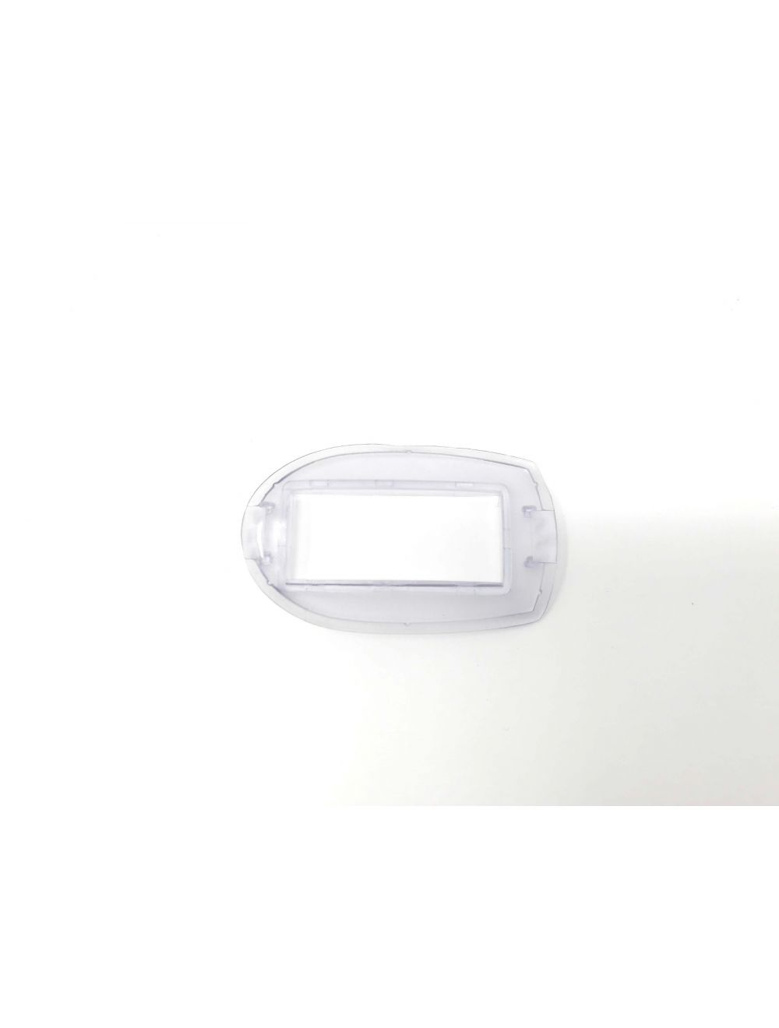
Pulsed Light
Notes:
First: A directional mirror gets the flash flash of white light from the Xenon flash lamp traveling in a one direction, (mimicking coherence)

Slide 36
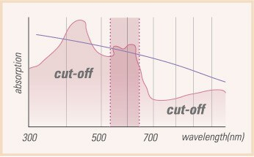
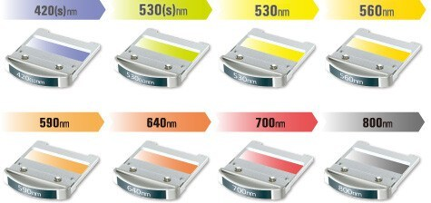
Pulsed Light
Notes:
Second: The white light passes through a colored filter in order to capture, and remove specific wavelengths contained in the flash of white light, (mimicking monochromaticity)

Slide 37
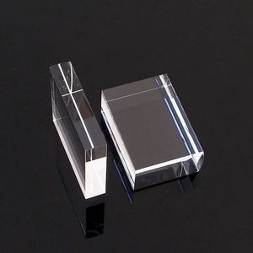
Pulsed Light
Notes:
Third: We capture this light in motion via a clear quartz or sapphire Light Guide that directs the light onto tissue (mimicking collimation)

Slide 38
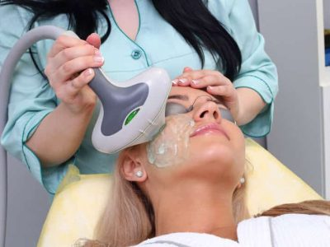
Pulsed Light
Notes:
Skin is cleansed and a thin layer of ultrasound gel is applied in order to better facilitate light penetration without undue heat transfer at the surface.

Slide 39
Pulsed Light
Notes:
IPL machines typically have multiple hand pieces or multiple filters that are changed for various treatments. The Light Guide is applied to the gel coated skin and pulsed.

Slide 40
Questions?
Notes:
IPL machines typically have multiple hand pieces or multiple filters that are changed for various treatments. The Light Guide is applied to the gel coated skin and pulsed.

Slide 41
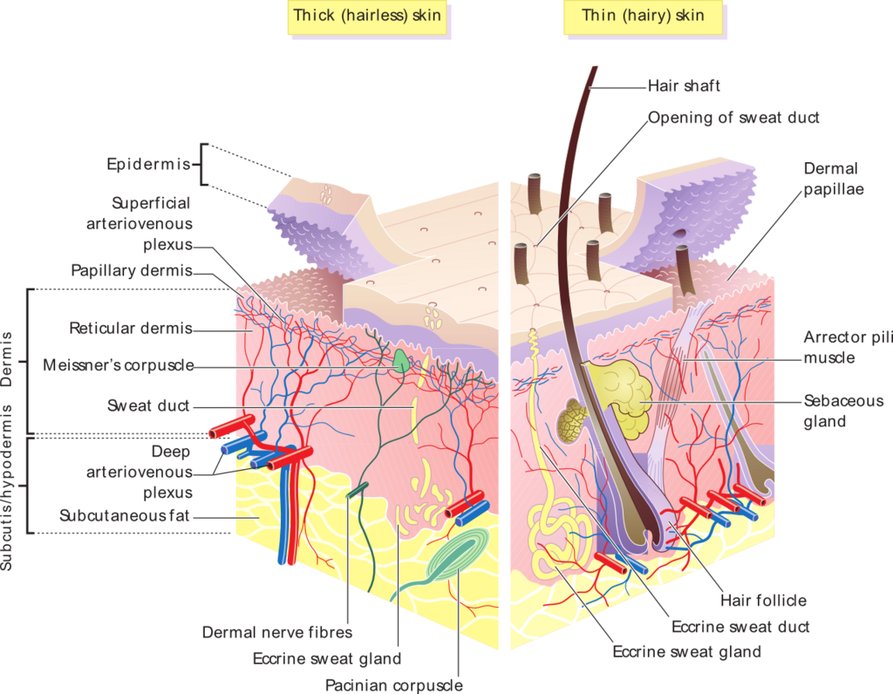
Skin Physiology
Notes:
Is there anyone here who is not familiar with basic skin physiology?

Slide 42
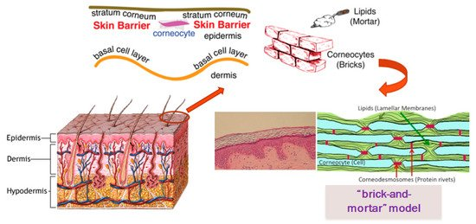
Skin Physiology
Notes:
The epidermis is an amazingly efficient barrier with corneocytes and lipids forming a wet/dry barrier that keeps all the bad stuff out.

Slide 43
Analysis and Skin Types

Slide 44
Analysis and Skin Types
Type Skin Color Reaction to Sun
I Caucasian with light hair Burns, never tans

Slide 45
Analysis and Skin Types
Type Skin Color Reaction to Sun
I Caucasian with light hair Burns, never tans
II Caucasian with dark hair Burns, may tan

Slide 46
Analysis and Skin Types
Type Skin Color Reaction to Sun
I Caucasian with light hair Burns, never tans
II Caucasian with dark hair Burns, may tan
III Asian, South Euro Burns, then tans

Slide 47
Analysis and Skin Types
Type Skin Color Reaction to Sun
I Caucasian with light hair Burns, never tans
II Caucasian with dark hair Burns, may tan
III Asian, South Euro Burns, then tans
IV Hispanic, Mediterranean Tans

Slide 48
Analysis and Skin Types
Type Skin Color Reaction to Sun
I Caucasian with light hair Burns, never tans
II Caucasian with dark hair Burns, may tan
III Asian, South Euro Burns, then tans
IV Hispanic, Mediterranean Tans
V Indian, African Heritage Tans, Black Skin

Slide 49
Analysis and Skin Types
Type Skin Color Reaction to Sun
I Caucasian with light hair Burns, never tans
II Caucasian with dark hair Burns, may tan
III Asian, South Euro Burns, then tans
IV Hispanic, Mediterranean Tans
V Indian, African Heritage Tans, Black Skin
VI African Heritage Tans, Black Skin

Slide 50
Score |  | 0 | 1 | 2 | 3 | 4
 | What is the color of your eyes? | Light Blue Gray or Green | Blue Gray or Green | Blue | Brown | Dark Brown to Black
 | What is the natural color of your hair? | Sandy Red | Blond | Brown Chestnut Dark Blond | Dark Brown | Black
 | What is the color of your skin in unexposed areas? | Reddish | Very Pale | Pale with Beige Tint | Light Brown | Dark Brown
 | Do you have freckles on sun exposed areas? | Many | Several | Few | Incidental | None
 | What happens when you stay in the sun too long? | Painful Redness, Blistering, Bleeding | Blistering Followed by Peeling | Burn, Sometimes Followed by Peeling | Rarely Burns | Has Never Burned
 | To what degree do you turn brown? | Hardly or Not at All | Light Tan Color | Dark Tan Color | Easily Turn Brown | Turn Dark Brown Quickly
 | Do you turn brown several hours after sun exposure | Never | Seldom | Sometimes | Often | Always
 | How does your face respond to the sun? | Very Sensitive | Sensitive | Normal | Very Resistant | Never have a problem
 | When did you last expose yourself to the sun, tanning bed or self tanning creams? | More than 3 Months Ago | 2-3 Months Ago | 1-2 Months Ago | Less than 1 Month Ago | Less than 2 Weeks Ago
 | Do you expose the area to be treated to the sun? | Never | Hardly Ever | Sometimes | Often | Always
Notes:
This is a skin type questionnaire. We can provide a copy.

Slide 51
Calculate the Patients Skin Type
Total Score: | Score 0-7 = Fitz I 8-16 = Fitz II 17-25 = Fitz III 26-30 = Fitz IV Over 30 = Fitz V to VI
Skin Type:

Slide 52
LANCER ETHNICITY SCALE (LES)
Notes:
The LES was developed to calculate healing and scar formation after surgery, but is a valuable aid for laser and IPL treatments as well. your LES type depends on your ethnicity. The lower your LES Skin Type, the better your skin heals after surgery or light based treatment, and the less risk there is of keloid scarring, erythema, discoloration, uneven pigmentation, hyper & hypo-pigmentation.

Slide 53
Add the LES numbers together and divide this total by four.
GEOGRAPHY | FITZPATRICK | LES SIGN TYPE
African Background
Central, East, West African | Skin Type V | LES Type 5
Eritrean and Ethiopian | Skin Type V | LES Type 5
North African, Middle East Arabic | Skin Type V | LES Type 5
Sephardic Jewish | Skin Type III | LES Type 4
Asian Background
Chinese, Korean, Japanese, Thai, Vietnamese | Skin Type IV | LES Type 4
Filipino, Polynesian | Skin Type IV | LES Type 4
European Background
Ashkenazy Jewish | Skin Type II | LES Type 3
Celtic | Skin Type I | LES Type 1
Central, Eastern European | Skin Type III | LES Type 2
Nordic | Skin Type I-II | LES Type 1
Northern European (general) | Skin Type I | LES Types 1-2
Southern European, Mediterranean | Skin Type III | LES Types 3-4
Latin/Central/South American Background
Central / South American Indian | Skin Type IV | LES Type 4
North American Background
Native American (including Inuit) | Skin Type II | LES Type 3
Notes:
We can provide a copy

Slide 54
Break
Next we will discuss light tissue interaction, choosing settings, contraindications, prep, interoperative care, post care and have a Q&A session

Slide 55
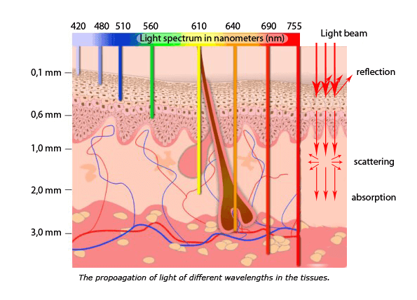
Light/Tissue Interaction
Notes:
To use light to safely and effectively to treat skin imperfections we must understand how light interacts with tissue and the mechanics underlying the effect light has on both the skin and the targeted imperfections. Understanding a number of factors will helps us develop our treatment technique and determine settings.

Slide 56
Light/Tissue Interaction
Chromophores

Slide 57
Light/Tissue Interaction
Chromophores
Absorption Characteristics

Slide 58
Light/Tissue Interaction
Chromophores
Absorption Characteristics
Selective Photothermolysis

Slide 59
Light/Tissue Interaction
Chromophores
Absorption Characteristics
Selective Photothermolysis
Depth of Penetration

Slide 60
Light/Tissue Interaction
Notes:
All forms of electromagnetic radiation flow to the point of least resistance. So just as water flows downhill, light naturally seeks to fill the darkness. Light passing through tissue will generally tend to confer an energy transfer when it encounters darker tissue. Hence, the general rule of thumb that darker skin types require more conservative treatment than lighter skin types, and darker targets can be treated more rapidly, and with less energy than lighter targets.

Slide 61
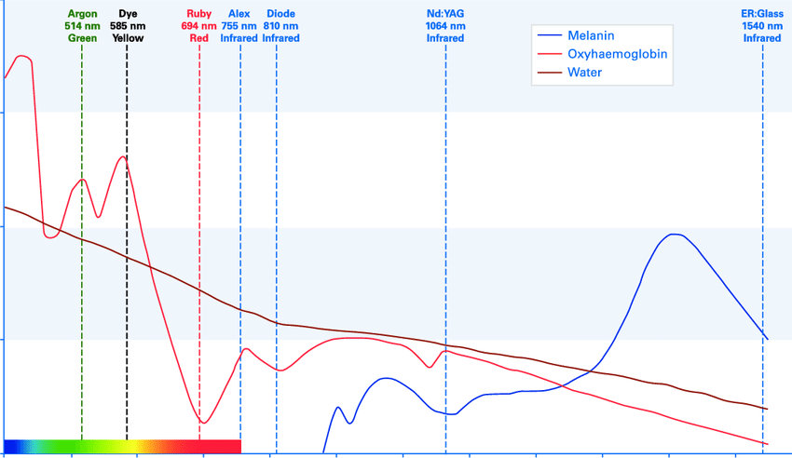
Chromophores
Notes:
A chromophore is a physical property in tissue that possesses absorption characteristics in relation to light. Absorption means that the light delivers energy to tissue. Absorption must take place for there to be any biologic effect, and a given color of light may be strongly absorbed by one type of tissue, and be transmitted or scattered by another. Each type of tissue has its specific absorption characteristics depending on its specific components, or chromophores.

Slide 62
Chromophores
The primary choromophores present in human tissue are:

Slide 63
Chromophores
The primary choromophores present in human tissue are:
Hemoglobin , (in blood)

Slide 64
Chromophores
The primary choromophores present in human tissue are:
Hemoglobin , (in blood)
Melanin, (in hair and skin)

Slide 65
Chromophores
The primary choromophores present in human tissue are:
Hemoglobin , (in blood)
Melanin, (in hair and skin)
Water, (prominently present in all tissue)

Slide 66
Chromophores
The primary choromophores present in human tissue are:
Hemoglobin , (in blood)
Melanin, (in hair and skin)
Water, (prominently present in all tissue) This is our primary chromophore during ablative LASER resurfacing

Slide 67
Chromophores
The primary choromophores present in human tissue are:
Hemoglobin , (in blood)
Melanin, (in hair and skin)
Water, (prominently present in all tissue) This is our primary chromophore during ablative LASER resurfacing
Protein, (often referred to as “scatter”, these are covalent bonds that connect tissue)

Slide 68
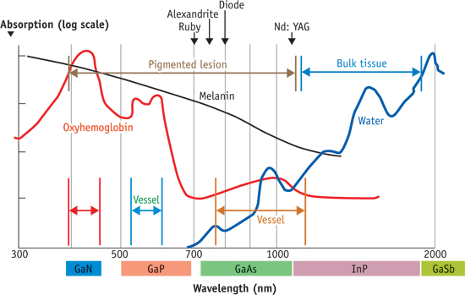
Absorption by Chromophores
Notes:
Infrared light is absorbed primarily by water, while visible and ultraviolet light are absorbed mainly by hemoglobin and melanin, respectively. As the wavelength decreases toward the blue-violet, and ultraviolet, scatter, or elements that limit the depth that light may penetrate into tissue, becomes more significant.

Slide 69
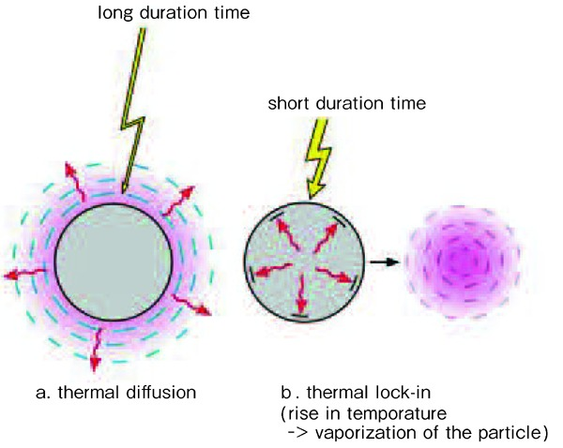
Absorption by Chromophores
Notes:
When light is absorbed, it delivers energy to tissue, and the tissue's reaction depends on the intensity and exposure time of the light. A high energy, short pulse of laser light will usually cause an explosive expansion of tissue, or photomechanical (photoacoustic) reaction.

Slide 70
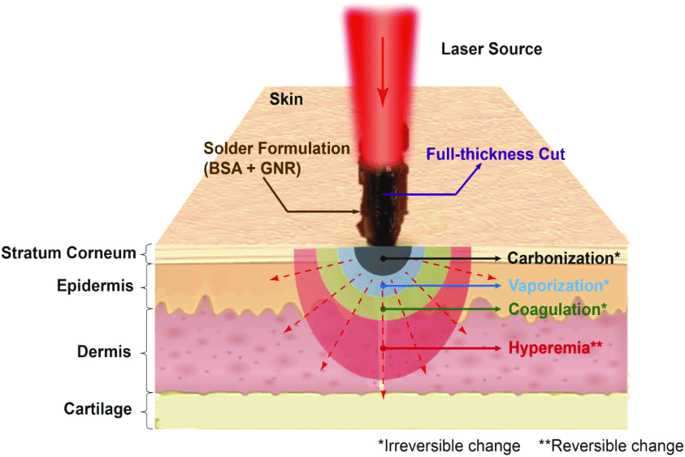
Absorption by Chromophores
Notes:
A lower energy, short pulse will cause a rapid heating, or photothermal effect. Lower energy applied for a longer pulsed can cause a photochemical change, either by a slow transfer of energy as heat or by a specific chemical reaction. A more intense, shorter pulse will cause a rapid heating, or photothermal, effect. Lower intensities applied for longer durations can cause a photochemical change, either by a slow transfer of energy as heat or by a specific chemical reaction. In actual practice, all of these interactions coexist, although by selecting the proper wavelength, energy level (fluence), and pulse duration, the desired effect can be maximized, while minimizing collateral tissue damage.

Slide 71
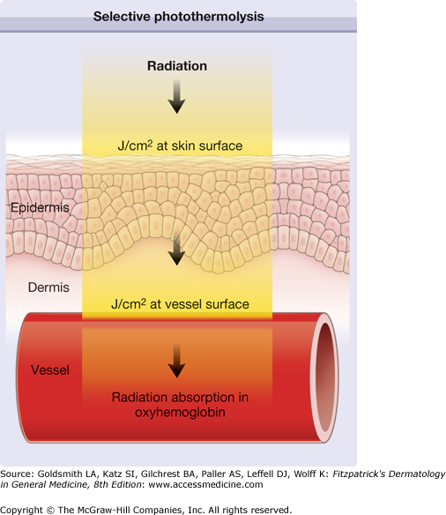
Selective Photothermolysis
Notes:
Selective – Discriminative, Photo – Light, Thermo – Heat, Lysis - Damage

Slide 72
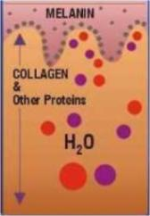
Targeted Chromophores
Pigments:
Epidermal melanin
Oxyhemoglobin: Arteries, arterioles, capillaries
Deoxyhemoglobin: Veins, venioles, capillaries
Water: Prominently present in all tissue

Slide 73
Selective Photothermolysis
For selective photothermolysis to occur, the operator must choose:

Slide 74
Selective Photothermolysis
For selective photothermolysis to occur, the operator must choose:
The appropriate Wavelength, (Color) selectively absorbed by the target tissue

Slide 75
Selective Photothermolysis
For selective photothermolysis to occur, the operator must choose:
The appropriate Wavelength, (Color) selectively absorbed by the target tissue
The appropriate pulse duration or “pulse width”

Slide 76
Selective Photothermolysis
For selective photothermolysis to occur, the operator must choose:
The appropriate Color (Wavelength)
The appropriate pulse duration or “pulse width”
The appropriate Energy, (called Fluence or Joules) to produce the desired effect

Slide 77
Selective Photothermolysis
For selective photothermolysis to occur, the operator must choose:
The appropriate Color (Wavelength)
The appropriate pulse duration or “pulse width”
The appropriate Energy, (called Fluence or Joules) to produce the desired effect
Spot Size

Slide 78
Depth of Penetration
Notes:
Again, these are a number of common aesthetic wavelengths, and their relative depth of penetration at the same energy levels.

Slide 79
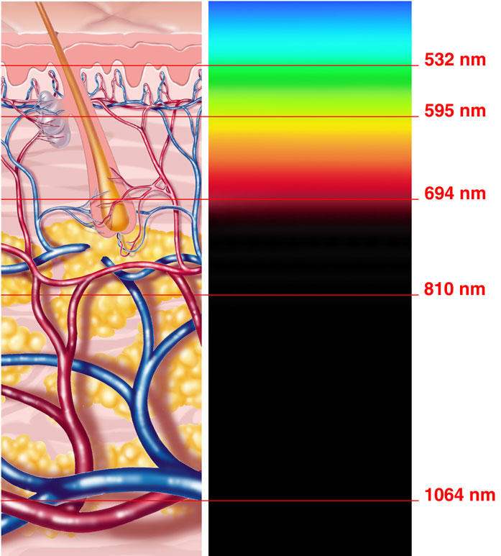
Depth of Penetration
Notes:
Using the same spot size and fluence, longer wavelengths are capable of deeper penetration

Slide 80
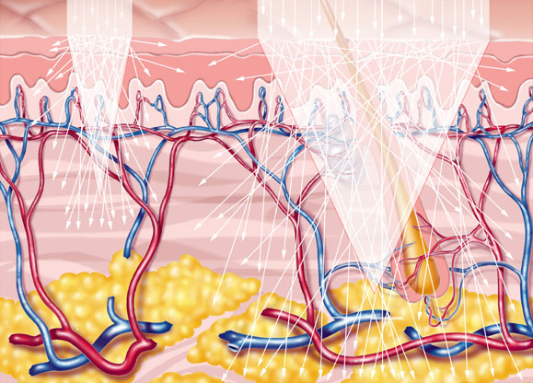
Spot Size & Depth of Penetration
Notes:
Using the same color and fluence, larger spot sizes allow deeper LASER light penetration, (and with IPL a only a somewhat broader light penetration).

Slide 81
Fluence and Depth of Penetration
Notes:
Using the same spot size and color, higher fluence, or more Joules produce deeper light penetration

Slide 82
Understanding LASER & IPL Settings
Choosing the appropriate settings
Contra-indications
Prep
Interoperative Care
Post Care

Slide 83
Choosing the Appropriate Settings

Slide 84
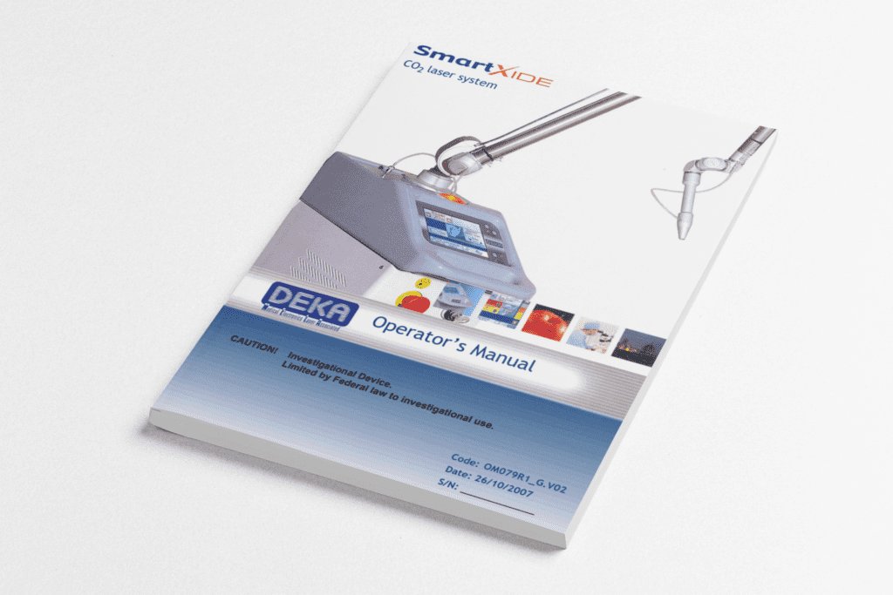
Choosing the Appropriate Settings
Notes:
Check your owners manual. Manufacturers will typically have a settings chart or suggested settings typically based upon skin color and skin condition.

Slide 85
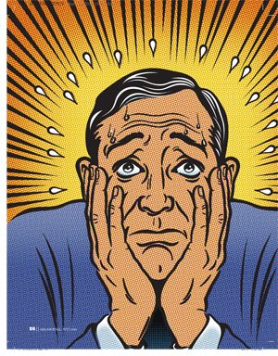
Choosing the Appropriate Settings
Notes:
Settings in the owners manual are generally conservative, and may not be ineffective because manufacturers err on the side of caution. Refer to your owners manual, or the doctors/previous technicians notes to establish some baseline settings.

Slide 86
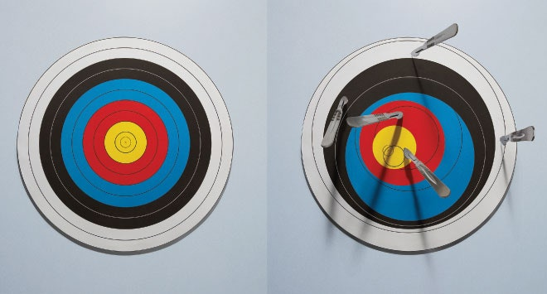
Choosing the Appropriate Settings
Notes:
Learning the settings on your particular machine will be a well regulated exercise in trial and error

Slide 87
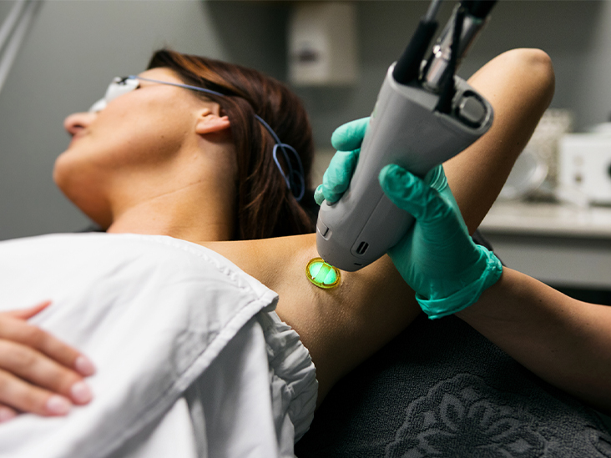
Choosing the Appropriate Settings
Notes:
To minimize the “error” side of things always perform a test-shot with what you determine to be a low, medium and high starting setting on the patient’s skin in an area not normally visible, but as close to the intended treatment area as possible. Let the patient’s skin recover from 1 to 3 days, depending on Fitzpatrick and any other suspected sensitivities.

Slide 88
Choosing the Appropriate Settings
Notes:
Depending on the skin type, LES and skin condition, the user manual will provide you with some baseline settings. Test shots are typically fired at 10% below and 10% above (J/cm2) manufacturers suggested settings

Slide 89
Choosing the Appropriate Settings
Notes:
The manufacturers suggestion for pulse width and wavelength are typically quite reliable

Slide 90
Choosing the Appropriate Settings
Notes:
We generally recommend never increasing fluence by more than 10% at a time as you try to work your way up to an energy level that produces the desired effect.

Slide 91
Contraindications
Standard surgical contraindications
Difficulty healing from burns and cuts
Antibiotics or other photosensitizing medications
Uncontrolled Diabetes or autoimmune disease
A tendency toward hypertrophic/keloid scarring
Accutane™ abstain 6 months
If the patient has experienced an unusual darkening or lightening of the skin after previous laser procedures

Slide 92
Prepatory Care
Antiviral prophylaxis against cutaneous herpes virus infection is essential before any ablative resurfacing
Because of the high prevalence of latent virus, even in persons who have never been symptomatic, prophylaxis is administered to all patients, beginning 24 hours before the procedure and continuing for 7-10 days.

Slide 93
Prepatory Care
Patients are instructed to avoid taking aspirin or other nonsteroidal anti-inflammatory medicines for at least 10 days in an effort to decrease bleeding during the procedure.
Pretreatment of the skin before laser resurfacing is common, especially in darker skin types.

Slide 94
Prepatory Care
Topical retinoic acids, hydroquinone bleaching agents, and alpha-hydroxy acids for several weeks pre-op can reduce post-op inflammation and hyperpigmentation. A typical 6-week preparation regimen before laser resurfacing is as follows:
Retinoic acid cream (0.05-0.1%): Apply 0.5-1 g in the evening.
Hydroquinone cream (2-4%): Apply 0.5-1 g twice daily.
Alpha-hydroxy acid cream (2-4%): Apply 0.5-1 g in the morning.

Slide 95
Prepatory Care
Oral Anesthetics such as Vicodin, Percocet, Valium and/or Xanax may be prescribed
Topical Anesthetic is applied 15-30 minutes prior to Tx
Skin is cleansed and disinfected with an alcohol swab
Allow skin to dry completely prior to pulsing

Slide 96
Interoperative Care
The image below represents the proper “side by side” technique for applying laser pulses.

Slide 97
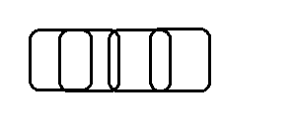
Interoperative Care
An improper “overlapping” technique delivers more energy than intended in the overlap areas and can lead to complications.

Slide 98
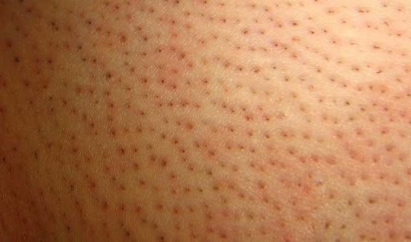
Interoperative Care
Notes:
For LASER or IPL Hair Removal perifollicular edema should be observed.

Slide 99
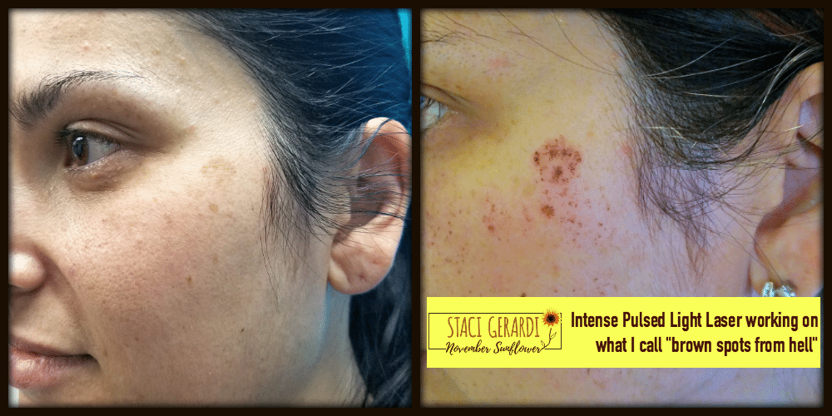
Interoperative Care
Notes:
IPL Photofacial should produce an immediate darkening of pigmented lesions. But surrounding tissue should not be overly inflamed

Slide 100
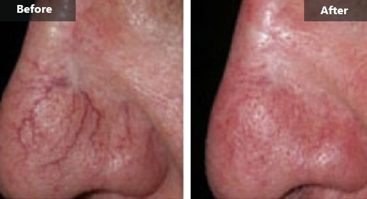
Interoperative Care
Notes:
IPL or LASER for vascular can produce an immediate darkening of the vessel. Or in some cases its disappearance. But surrounding tissue should not be overly inflamed.

Slide 101
Interoperative Care
Notes:
Ablative resurfacing should produce an even pattern of ablation.

Slide 102
Post Op Care
After ablative resurfacing, apply an occlusive ointment immediately post, and continually during the 1st 24 hours post procedure. Do not wash the treated area.
Apply cool compresses immediately and as desired after procedure. Some patients report a “hot” feeling that lasts from a few hours to a few days.
Schedule the patient for follow up visits at 24 hours, 3 days, 10 days & 30 days.

Slide 103
Post Op Care
Vinegar soaks may be applied frequently to decrease itching sensation and reduce possibility of infection.
Mix 1 tablespoon white vinegar with 1 pint of warm water.
Wet a soft cloth or gauze, soak procedure site for 15 minutes with dilute vinegar solution. Repeat hourly if desired.

Slide 104
Post Op Care
After 24 hours gently wash area with tepid water and a gentle cleanser 3 times a day
Then immediately re-apply occlusive ointment or intense moisturizer for at least the first 4 days, (and as long as any open wound exists).
The patient may shower after 24 hours, but avoid hot water/steam on the treated area.

Slide 105
Post Op Care
For LASER or IPL: Avoid “picking at” and aggressive scrubbing of the “coffee grounds” or exfoliating skin -- allow it to gently exfoliate with gentle washing.
Sleeping with head elevated on pillows (head above heart) for up to 3 nights post procedure can help minimize swelling.
In general keep the treated area clean, moist and protected from the sun. Apply sun block SPF 20+ whenever prolonged sun exposure is likely.

Slide 106
Questions
Notes:
Questions?

